Slide 1
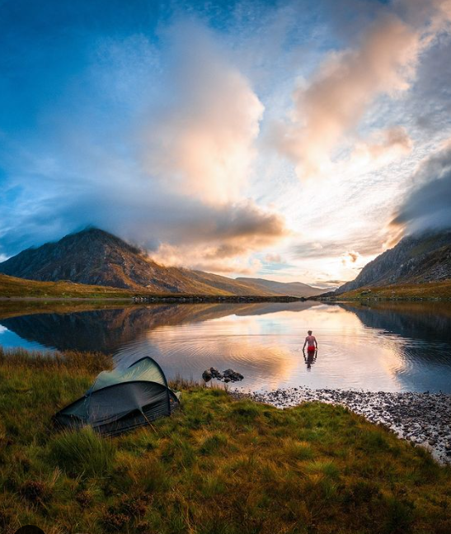
MyTrip
Username:
Password:
Come in!

Slide 2
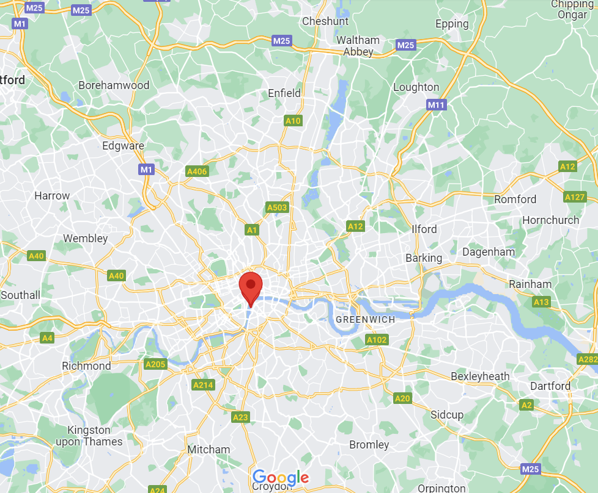
MyTrip
Log out
Add new trip

Slide 3
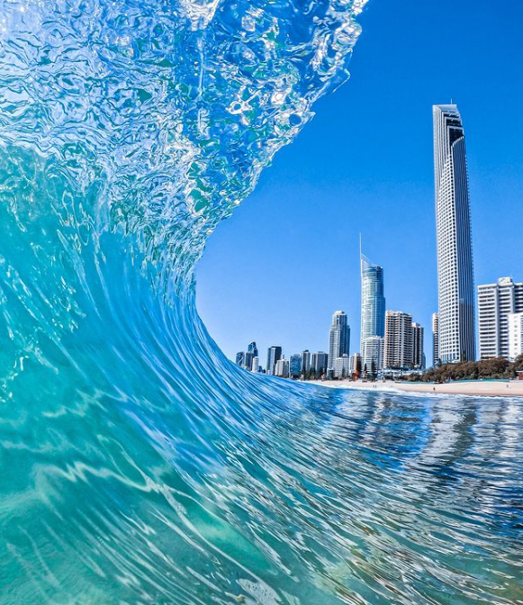
MyTrip
Destination:
___________
__________________________________________
Description
Photo
Cancel
Save

Slide 4
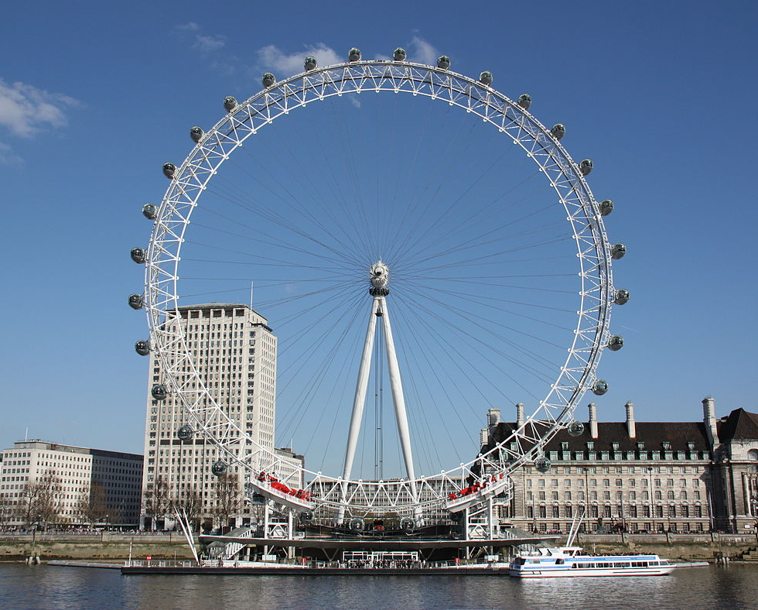
MyTrip
Destination:
London
A city for young people, lots of bars and entertainment places. Shopping prices are high.
Description
back

